Slide 1
Segmented Trees:
Range Minimum Query
By: Prachi Prashant Phatale(199005660)
& Abiola Anderson(128001260)

Slide 2

Introduction
Minimum in the range (0,3)= -1
0 1 2 3 4 5
Time complexity-O(mn) where m is number of queries and n is size of the array.

Slide 3
Introduction
A Segment Tree is a data structure that allows answering range queries over an array effectively, while still being flexible enough to allow modifying the array. It is a binary tree, and the elements of this array are the leaf of the binary tree.
Representation of Segment trees
1. Leaf Nodes are the elements of the input array.
2. Each internal node represents minimum of all leaves under it.

Slide 4


Construction of segtree
0 1 2 3 4 5

Slide 5
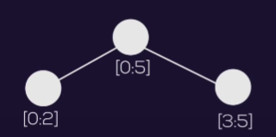
Construction of segtree
0 1 2 3 4 5

Slide 6
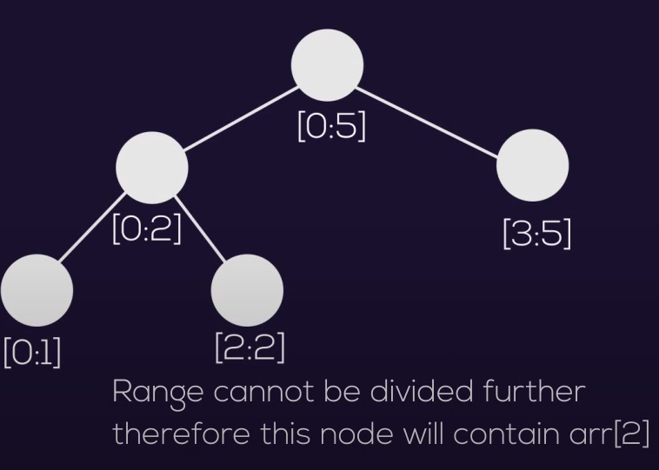
Construction of segtree
0 1 2 3 4 5

Slide 7
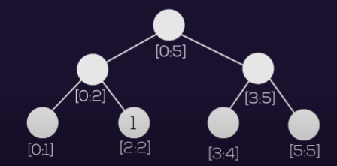
Construction of segtree
0 1 2 3 4 5

Slide 8
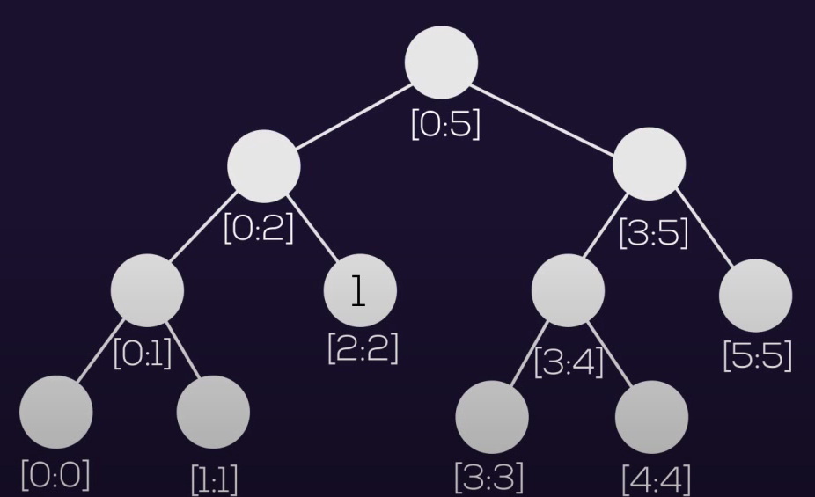
Construction of segtree
0 1 2 3 4 5

Slide 9
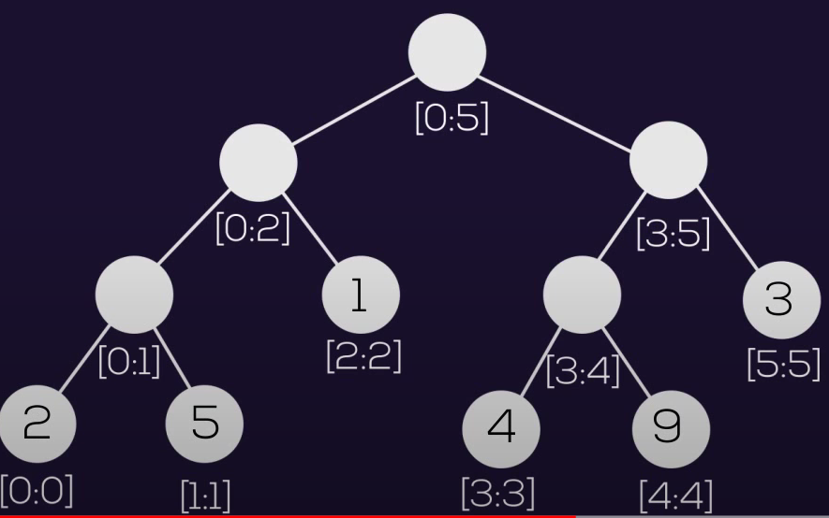
Construction of segtree
0 1 2 3 4 5

Slide 10
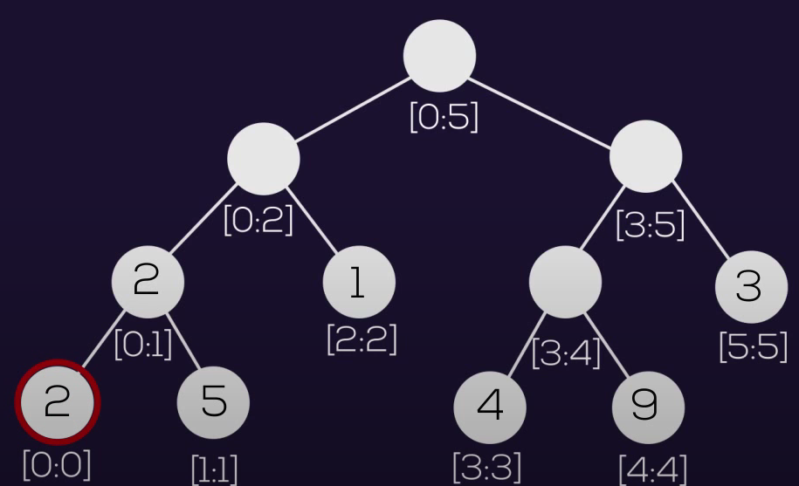
Construction of segtree
0 1 2 3 4 5

Slide 11
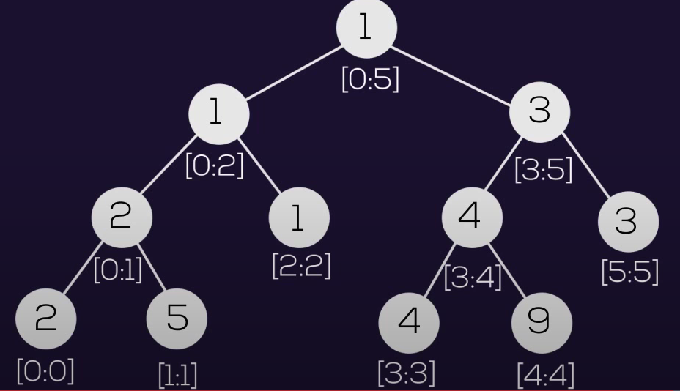
Construction of segtree
0 1 2 3 4 5

Slide 12
3 Rules for Range Query
1.Partial overlap of intervals- Look in both the directions
2.Total overlap of Intervals-Take minimum of it
3.No overlap of intervals-Take maximum number(infinity) of it

Slide 13
Range = [2,4]
Minimum in the range[2,4]=1

Slide 14
Time Complexity
To build a segtree - O(n)
Space to maintain a segtree - O(n)
Time to answer a query O(logn)

Slide 15
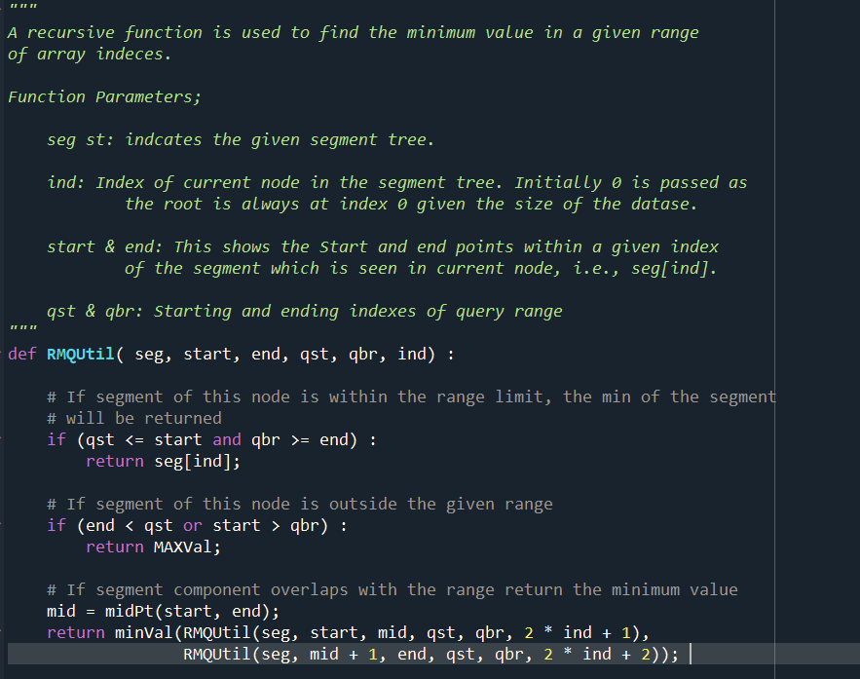
Code
The main focus is focus in the code was to develop the RMQ and RMQU.
At first the program was run on a smaller dataset to test.
The goal is to apply a larger dataset for more efficient processing

Slide 16
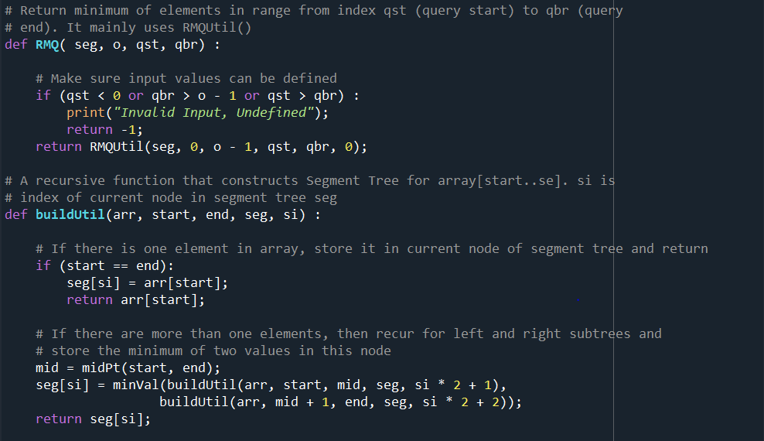
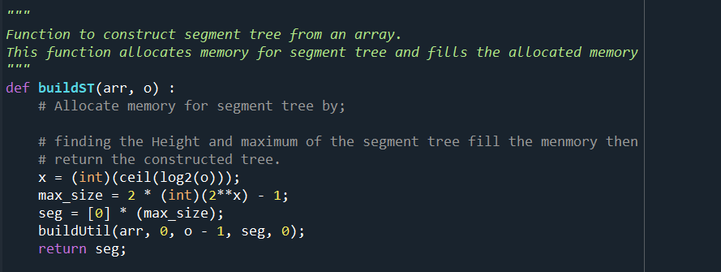
Code (cont.)

Slide 17
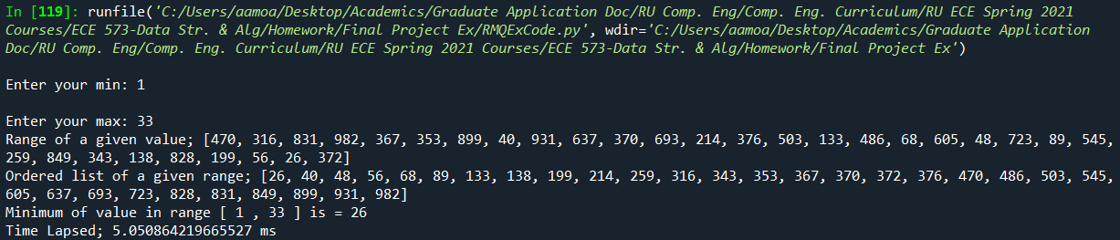

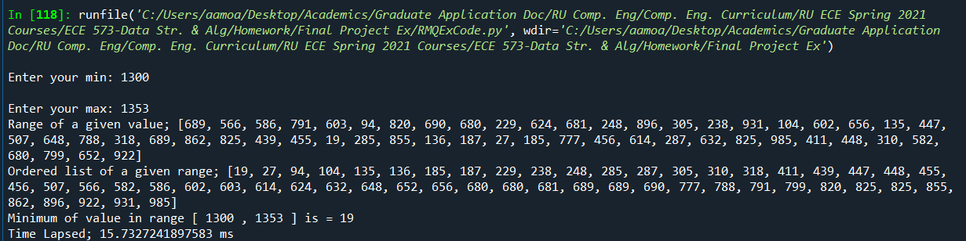
Results
The Driver code is then used to generate a given output
This is done through the use of a range pulled directly from the Dataset

Slide 18
Size of database | Runtime(ms)
8 int | 7.336230283
32 int | 8.070910644
128 int | 8.878664045
512 int | 9.754644355
1024 int | 9.889781885
4096 int | 10.25110004
4192 int | 10.71749693
8192 int | 10.71654866
16384 int | 11.4002723
32768 int | 11.52264783
65536 int | 11.83730287
131072 int | 12.4296171
Size of database | Runtime(ms)
262144 int | 13.67191538
524288 int | 13.8355573
1048576 int | 16.16887314
8388608 int | 16.65704837

Slide 19
Conclusion & Application
A Segment Tree can be used for both integers and strings when applied it can work with both data and information as a static structure.
Range Minimum Query provides a nuanced approach for finding the lowest value in the subsection of an array in a static structure.
In Computer Science there are numerous use cases. This one presents the lowest common ancestor.
Variants of range Minimum Query can be seen in certain real world areas such as Sports and Online Gaming.

Slide 20
THANK YOU!

